Slide 1
Cambridge Global Food Security Symposium 2019
9 April 2019
Food Sustainability Index:
Overview and Key Findings
Martin Koehring
Managing Editor, Thought Leadership
The Economist Intelligence Unit

Slide 2
What is the Food Sustainability Index?
The Food Sustainability Index (FSI) measures the sustainability of food systems in 67 countries across three pillars outlined in the 2015 BCFN Milan Protocol, and is designed around the Sustainable Development Goals (SDGs).
The FSI contains 37 indicators and 89 individual metrics that address societal, environmental and economic themes.
The index was developed by The Economist Intelligence Unit with the Barilla Center for Food & Nutrition.
What is food sustainability?
Milan Protocol:
Three pillars
Food loss and waste
Sustainable agriculture
Nutritional challenges
Food sustainability is defined as the ability of a country’s food system to be maintained without depletion and exhaustion of natural resources or compromises to health and integrity, and without compromising future generations’ access to food.
Almost 1bn people suffer from hunger, but a third of food is lost or wasted. Food loss and waste are rapidly moving up the policy agenda.
The world is running out of cultivatable land. More sustainable farming techniques are needed.
Developing countries are facing the double burden of hunger and a growing threat of obesity.

Slide 3
Examples of key FSI indicators
Food lost as % of total food
Policy response to food loss
Causes of distribution-level loss
Solutions to distribution-level loss
Food waste per capita per year
Policy response to food waste
Food loss & waste
Undernourishment
Stunting
Micronutrient deficiency
Healthy life expectancy
Prevalence of overweight
DALYs for nutrition deficiencies
Physical activity
Sugar in diets
Meat consumption
Salt consumption
GINI coefficient
Policy response to dietary patterns
Nutrition education
Water footprint
Ag water withdrawals
Initiatives to recycle water for ag
FSI
Fish stocks
Nitrogen Use Efficiency
Land under organic ag
Sustainable urban farming initiatives
Laws to protect smallholders
Quality of ag subsidies
Biodiversity
R&D expenditure
Total factor productivity
Sustainable
Nutritional
agriculture
challenges
Women in farming
GHG emissions from ag
Ag techniques for climate change mitigation

Slide 4
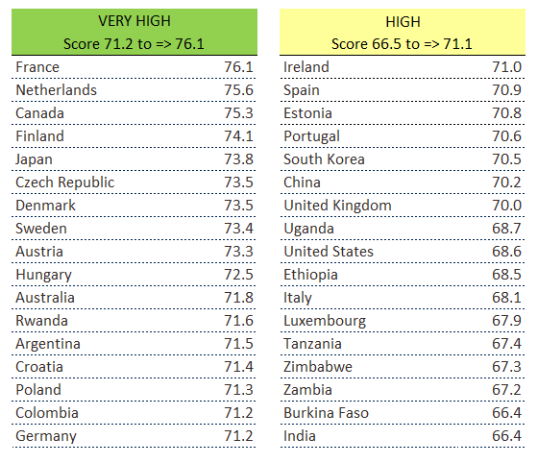
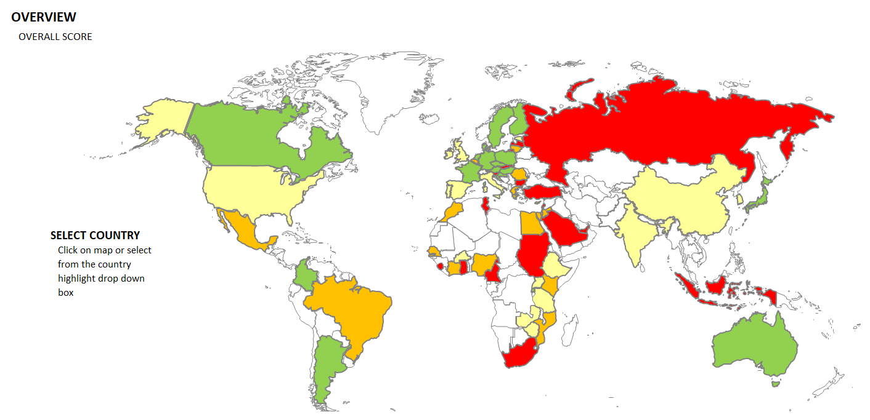
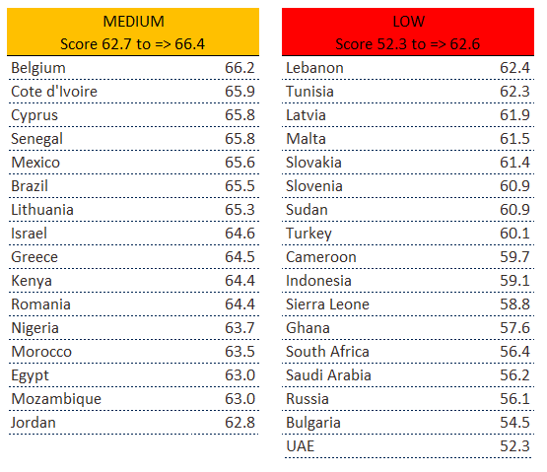
FSI 2018 results
France is in first place among 35 high-income countries in the 2018 edition of the FSI, followed by the Netherlands and Canada.
Colombia is the leading middle-income country, out of 23.
Among nine low-income countries, Rwanda shows the strongest performance, ahead of Uganda in second place and Ethiopia in third.
Notes:
4

Slide 5
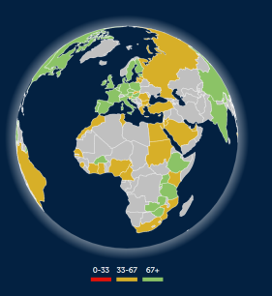
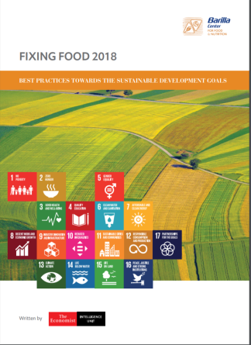
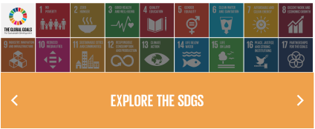
For more information
http://foodsustainability.eiu.com/
Heat map with country ranking
http://foodsustainability.eiu.com/
heat-map/
Guest blogs from influencers (José Graziano da Silva, Kofi Annan, European Commissioner etc) & blogs linked to global awareness days and key trends
http://foodsustainability.eiu.com/
resources/#blogs
White paper focusing on global best practices
http://foodsustainability.eiu.com/
whitepaper-2018/
Plus: infographics (e.g. how food systems matter to all SDGs), white papers (e.g. focusing on Mediterranean region), full data set, methodology paper etc.
Interested in more information or opportunities for collaboration?
Martin Koehring
Managing Editor, Thought Leadership
The Economist Intelligence Unit
martinkoehring@economist.com
@EconomistMartin
Notes:
5

